Slide 1
Outline
Sample的計算方式
各機器的TTP統計與分析
TTP類型分析(sample與event的關係)
與網路相關的sample(網路的資訊只有協定有幫助)

Slide 2
Sample算法 - system_labels
以下內容為一個sample
"e16ea6a3c00b40cdbd5899b735ce71e4": {
"id": "e16ea6a3c00b40cdbd5899b735ce71e4",
"auditd_events": {
"start": [
"360240",
"360241",
"360242",
"360243"
]
},
"technique": "T1018: Remote System Discovery"
},
Sample的id
Sample所在的機器
Event的id 內容存放在 Cache/Syslogs/"team"/audit.log 裡
該Sample所屬的TTP

Slide 3
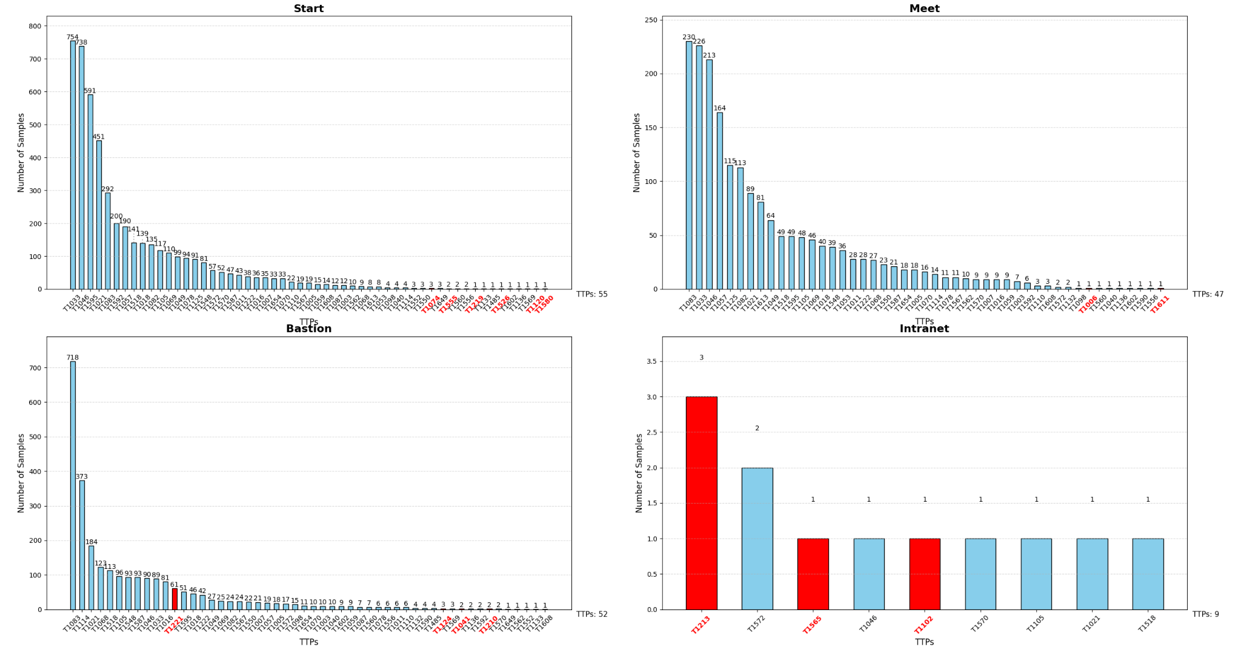
Notes:
show sample算法
哪些TTP兩個機器
哪些TTP會跟網路連結

Slide 4
跨機器的TTP
TTP 編號 | 描述 (參考) | 出現次數
T1033 | System Owner/User Discovery | 12
T1021 | Remote Services | 7
T1572 | Protocol Tunneling | 5
T1082 | System Information Discovery | 3
T1049 | System Network Connections Discovery | 3
T1046 | Network Service Discovery | 2
T1110 | Brute Force | 2
T1083 | File and Directory Discovery | 2
T1057 | Process Discovery | 1
T1592 | Gather Victim Host Information | 1
T1018 | Remote System Discovery | 1
T1595 | Active Scanning | 1
T1587 | Develop Capabilities | 1
T1003 | OS Credential Dumping | 1
T1556 | Modify Authentication Process | 1

Slide 5
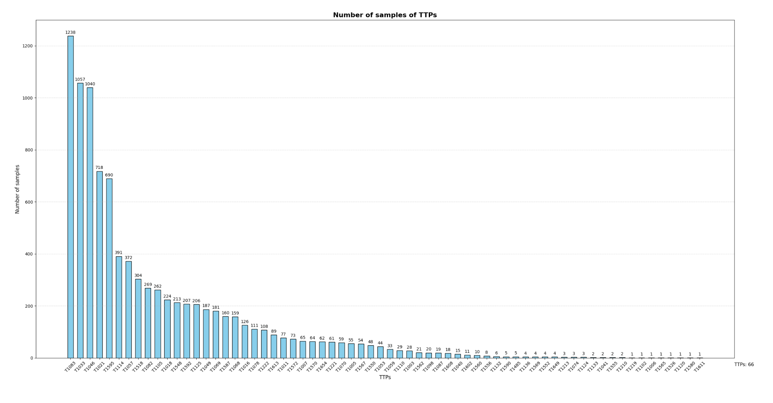

Slide 6
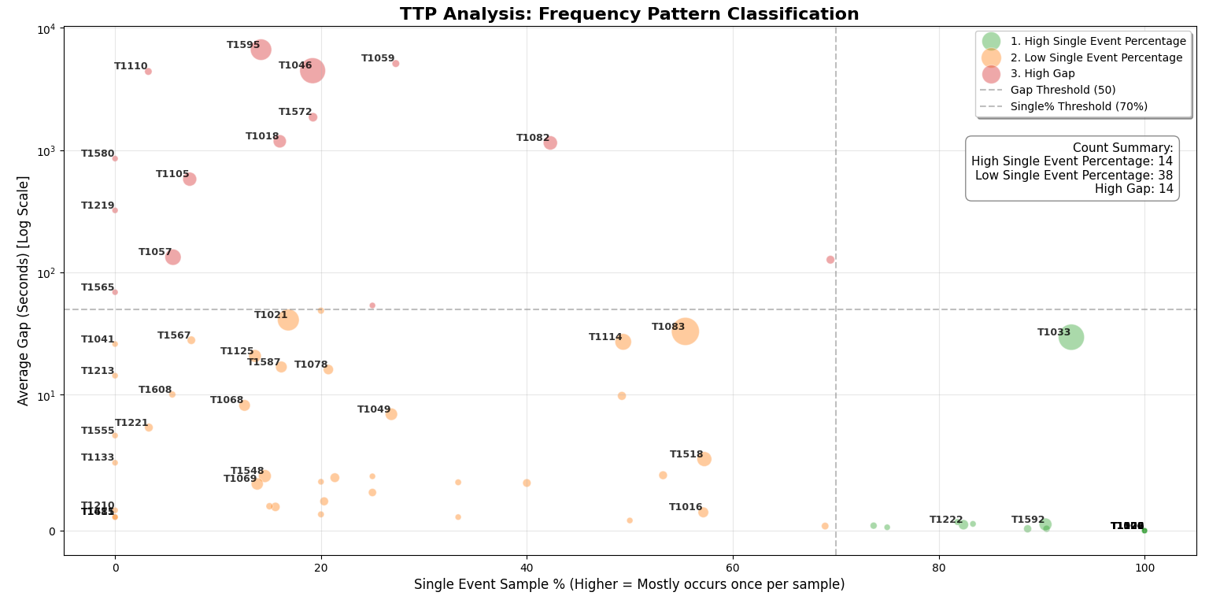

Slide 7
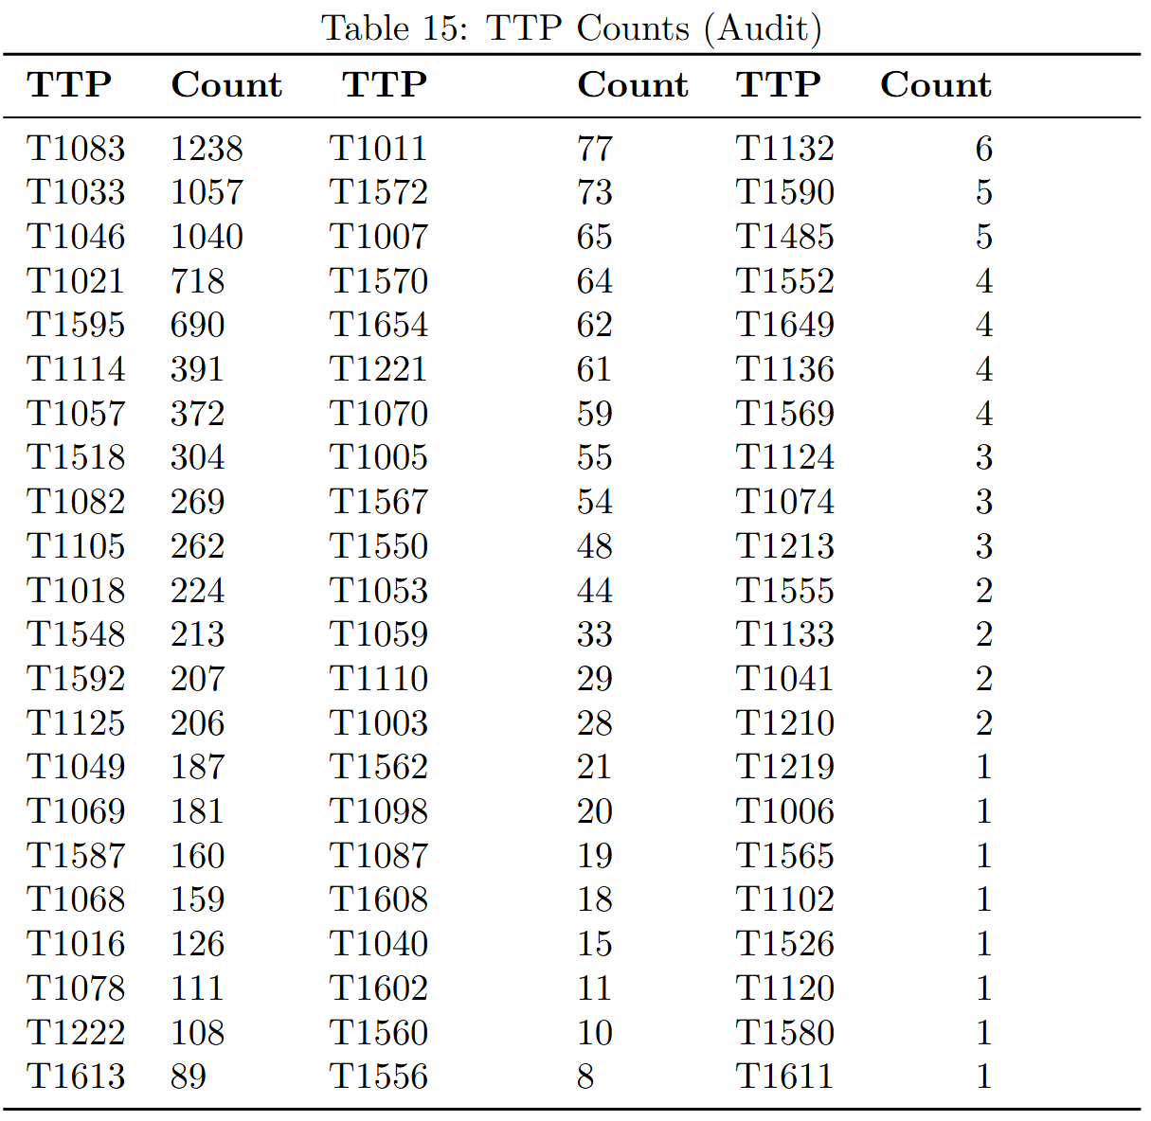
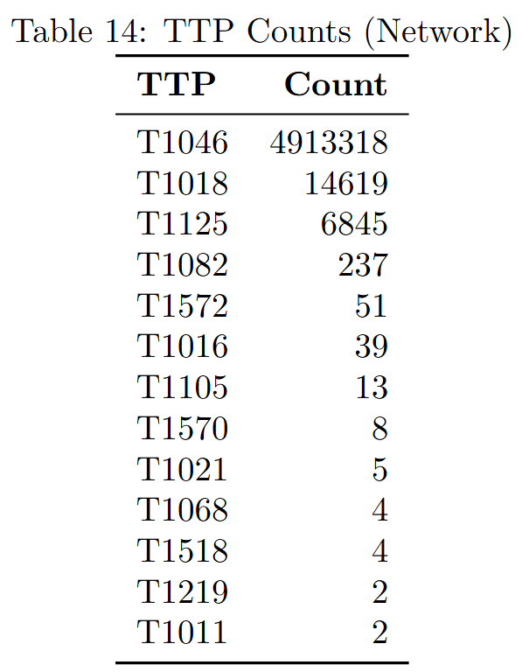
Statistic of TTPs - 66TTPs
Linked events
Total benign processes: 404,637
Total malicious processes: 9,243
Total benign events: 32,365,532
Total malicious events: 62,609,868
Notes:
看T1011 了解一下audit -> network的過程
是否要看network log才能觀察attack

Slide 8
Example list
single:
T1074
T1102
T1006
T1526
T1120
mutiple &no gap
T1485
T1611
T1210
T1133
T1213
Notes:
拆解讀event
拆80%資料 然後測設
表格生出來 Darpa E5 的parse

Slide 9
T1074: Data Staged - 1 event
指令在 /var/www/welcome 目錄下執行的。
通常是 Web Server 的公開目錄。
"type=PATH msg=audit(1715977342.877:136935): item=0 name=\"/var/www/welcome\" inode=131219 dev=08:01 mode=040755 ouid=0 ogid=0 rdev=00:00 nametype=PARENT cap_fp=0 cap_fi=0 cap_fe=0 cap_fver=0 cap_frootid=0\u001dOUID=\"root\" OGID=\"root\"",
"type=PATH msg=audit(1715977342.877:136935): item=1 name=\"/etc/shadow\" nametype=UNKNOWN cap_fp=0 cap_fi=0 cap_fe=0 cap_fver=0 cap_frootid=0",
"type=SYSCALL msg=audit(1715977342.877:136935): arch=c000003e syscall=266 success=no exit=-13 a0=7fffa3df273c a1=ffffff9c a2=7fffa3df1cc0 a3=7fffa3dfa080 items=3 ppid=46114 pid=46352 auid=1001 uid=1001 gid=1001 euid=1001 suid=1001 fsuid=1001 egid=1001 sgid=1001 fsgid=1001 tty=pts2 ses=58 comm=\"ln\" exe=\"/usr/bin/ln\" subj=unconfined key=\"file_creation\"\u001dARCH=x86_64 SYSCALL=symlinkat AUID=\"tbenedict\" UID=\"tbenedict\" GID=\"tbenedict\" EUID=\"tbenedict\" SUID=\"tbenedict\" FSUID=\"tbenedict\" EGID=\"tbenedict\" SGID=\"tbenedict\" FSGID=\"tbenedict\"",
"type=PROCTITLE msg=audit(1715977342.877:136935): proctitle=6C6E002D73666E002F6574632F736861646F7700736E617073686F742E6A7067",
"type=PATH msg=audit(1715977342.877:136935): item=2 name=\"CuHNQpxq\" nametype=CREATE cap_fp=0 cap_fi=0 cap_fe=0 cap_fver=0 cap_frootid=0"
本次攻擊失敗
ln -sfn /etc/shadow snapshot.jpg
Notes:
ln: 建立連結 (Link) 指令。
-sfn: 建立符號連結 (Symbolic)，強制覆寫 (Force)，不解參考 (No-dereference)。
/etc/shadow: 來源檔案。這是 Linux 系統中存放使用者密碼雜湊 (Hash) 的極機密檔案。
snapshot.jpg: 目標檔名。攻擊者故意將其命名為「照片檔」。

Slide 10
T1102: Web Service - 1 event
攻擊者在受害者的 Docker 容器內，用root的身分利用 Node.js 啟動了一個 Web Server
"type=SYSCALL msg=audit(1715996060.045:270756): arch=c000003e syscall=41 success=yes exit=20 a0=a a1=80801 a2=0 a3=7 items=0 ppid=92158 pid=92159 auid=4294967295 uid=0 gid=0 euid=0 suid=0 fsuid=0 egid=0 sgid=0 fsgid=0 tty=pts0 ses=4294967295 comm=\"node\" exe=\"/usr/local/bin/node\" subj=docker-default key=\"network_socket_created\"\u001dARCH=x86_64 SYSCALL=socket AUID=\"unset\" UID=\"root\" GID=\"root\" EUID=\"root\" SUID=\"root\" FSUID=\"root\" EGID=\"root\" SGID=\"root\" FSGID=\"root\"",
"type=PROCTITLE msg=audit(1715996060.045:270756): proctitle=6E6F6465002E2F62696E2F777777"
node ./bin/www

Slide 11
T1006: Direct Volume Access - 1 event
"type=PATH msg=audit(1715981033.125:128161): item=0 name=\"/dev/sda14\" inode=195 dev=00:05 mode=060660 ouid=0 ogid=6 rdev=08:0e nametype=NORMAL cap_fp=0 cap_fi=0 cap_fe=0 cap_fver=0 cap_frootid=0\u001dOUID=\"root\" OGID=\"disk\"",
"type=PROCTITLE msg=audit(1715981033.125:128161): proctitle=636174002F6465762F7364613134",
"type=SYSCALL msg=audit(1715981033.125:128161): arch=c000003e syscall=257 success=no exit=-13 a0=ffffff9c a1=7ffd34e5374e a2=0 a3=0 items=1 ppid=16497 pid=28316 auid=1005 uid=1005 gid=1005 euid=1005 suid=1005 fsuid=1005 egid=1005 sgid=1005 fsgid=1005 tty=pts1 ses=21 comm=\"cat\" exe=\"/usr/bin/cat\" subj=unconfined key=\"file_access\"\u001dARCH=x86_64 SYSCALL=openat AUID=\"tbenedict\" UID=\"tbenedict\" GID=\"tbenedict\" EUID=\"tbenedict\" SUID=\"tbenedict\" FSUID=\"tbenedict\" EGID=\"tbenedict\" SGID=\"tbenedict\" FSGID=\"tbenedict\""
cat /dev/sda14
執行失敗

Slide 12
T1526: Cloud Service Discovery - 1 event
"type=SYSCALL msg=audit(1715980805.087:66829): arch=c000003e syscall=59 success=yes exit=0 a0=5585c78a9070 a1=5585c7839fd0 a2=5585c7848bc0 a3=e309313a391b31ff items=3 ppid=34759 pid=34764 auid=1001 uid=1001 gid=1001 euid=1001 suid=1001 fsuid=1001 egid=1001 sgid=1001 fsgid=1001 tty=pts1 ses=54 comm=\"curl\" exe=\"/usr/bin/curl\" subj=unconfined key=\"susp_activity\"\u001dARCH=x86_64 SYSCALL=execve AUID=\"tbenedict\" UID=\"tbenedict\" GID=\"tbenedict\" EUID=\"tbenedict\" SUID=\"tbenedict\" FSUID=\"tbenedict\" EGID=\"tbenedict\" SGID=\"tbenedict\" FSGID=\"tbenedict\"",
"type=PATH msg=audit(1715980805.087:66829): item=1 name=\"/usr/bin/curl\" inode=16470 dev=08:01 mode=0100755 ouid=0 ogid=0 rdev=00:00 nametype=NORMAL cap_fp=0 cap_fi=0 cap_fe=0 cap_fver=0 cap_frootid=0\u001dOUID=\"root\" OGID=\"root\"",
"type=PATH msg=audit(1715980805.087:66829): item=0 name=\"/usr/bin/curl\" inode=16470 dev=08:01 mode=0100755 ouid=0 ogid=0 rdev=00:00 nametype=NORMAL cap_fp=0 cap_fi=0 cap_fe=0 cap_fver=0 cap_frootid=0\u001dOUID=\"root\" OGID=\"root\"",
"type=PROCTITLE msg=audit(1715980805.087:66829): proctitle=6375726C00687474703A2F2F6D657461646174612E676F6F676C652E696E7465726E616C2F636F6D707574654D657461646174612F76312F3F7265637572736976653D7472756526616C743D74657874002D48",
"type=EXECVE msg=audit(1715980805.087:66829): argc=3 a0=\"curl\" a1=\"http://metadata.google.internal/computeMetadata/v1/?recursive=true&alt=text\" a2=\"-H\"",
"type=PATH msg=audit(1715980805.087:66829): item=2 name=\"/lib64/ld-linux-x86-64.so.2\" inode=2060 dev=08:01 mode=0100755 ouid=0 ogid=0 rdev=00:00 nametype=NORMAL cap_fp=0 cap_fi=0 cap_fe=0 cap_fver=0 cap_frootid=0\u001dOUID=\"root\" OGID=\"root\""
curl http://metadata.google.internal/computeMetadata/v1/?recursive=true&alt=text" -H "Metadata-Flavor: Google"

Slide 13
T1120: Peripheral Device Discovery - 1 event
"type=SYSCALL msg=audit(1715995596.470:42460): arch=c000003e syscall=257 success=no exit=-13 a0=ffffff9c a1=55f7f5d717f0 a2=241 a3=1b6 items=2 ppid=25550 pid=25668 auid=1001 uid=1001 gid=1001 euid=1001 suid=1001 fsuid=1001 egid=1001 sgid=1001 fsgid=1001 tty=pts1 ses=60 comm=\"nano\" exe=\"/usr/bin/nano\" subj=unconfined key=\"file_access\"\u001dARCH=x86_64 SYSCALL=openat AUID=\"tbenedict\" UID=\"tbenedict\" GID=\"tbenedict\" EUID=\"tbenedict\" SUID=\"tbenedict\" FSUID=\"tbenedict\" EGID=\"tbenedict\" SGID=\"tbenedict\" FSGID=\"tbenedict\"",
"type=PATH msg=audit(1715995596.470:42460): item=0 name=\"/usr/lib/x86_64-linux-gnu/e2fsprogs/\" inode=1675 dev=08:01 mode=040755 ouid=0 ogid=0 rdev=00:00 nametype=PARENT cap_fp=0 cap_fi=0 cap_fe=0 cap_fver=0 cap_frootid=0\u001dOUID=\"root\" OGID=\"root\"",
"type=PATH msg=audit(1715995596.470:42460): item=1 name=\"/usr/lib/x86_64-linux-gnu/e2fsprogs/e2scrub_all_cron\" inode=1402 dev=08:01 mode=0100755 ouid=0 ogid=0 rdev=00:00 nametype=NORMAL cap_fp=0 cap_fi=0 cap_fe=0 cap_fver=0 cap_frootid=0\u001dOUID=\"root\" OGID=\"root\"",
"type=PROCTITLE msg=audit(1715995596.470:42460): proctitle=6E616E6F002F7573722F6C69622F7838365F36342D6C696E75782D676E752F6532667370726F67732F653273637275625F616C6C5F63726F6E"

Slide 14
T1133: External Remote Services - 2 events
"type=SYSCALL msg=audit(1715987548.224:41505): arch=c000003e syscall=59 success=yes exit=0 a0=563230f290a0 a1=563230e3c180 a2=563230f1dc00 a3=c633542509c49b85 items=3 ppid=12533 pid=12943 auid=1001 uid=1001 gid=1001 euid=1001 suid=1001 fsuid=1001 egid=1001 sgid=1001 fsgid=1001 tty=pts0 ses=70 comm=\"curl\" exe=\"/usr/bin/curl\" subj=unconfined key=\"susp_activity\"\u001dARCH=x86_64 SYSCALL=execve AUID=\"tbenedict\" UID=\"tbenedict\" GID=\"tbenedict\" EUID=\"tbenedict\" SUID=\"tbenedict\" FSUID=\"tbenedict\" EGID=\"tbenedict\" SGID=\"tbenedict\" FSGID=\"tbenedict\"",
"type=EXECVE msg=audit(1715987548.224:41505): argc=2 a0=\"curl\" a1=\"172.105.77.209\"",
"type=PATH msg=audit(1715987548.224:41505): item=0 name=\"/usr/bin/curl\" inode=16470 dev=08:01 mode=0100755 ouid=0 ogid=0 rdev=00:00 nametype=NORMAL cap_fp=0 cap_fi=0 cap_fe=0 cap_fver=0 cap_frootid=0\u001dOUID=\"root\" OGID=\"root\"",
"type=PATH msg=audit(1715987548.224:41505): item=1 name=\"/usr/bin/curl\" inode=16470 dev=08:01 mode=0100755 ouid=0 ogid=0 rdev=00:00 nametype=NORMAL cap_fp=0 cap_fi=0 cap_fe=0 cap_fver=0 cap_frootid=0\u001dOUID=\"root\" OGID=\"root\"",
"type=PATH msg=audit(1715987548.224:41505): item=2 name=\"/lib64/ld-linux-x86-64.so.2\" inode=2060 dev=08:01 mode=0100755 ouid=0 ogid=0 rdev=00:00 nametype=NORMAL cap_fp=0 cap_fi=0 cap_fe=0 cap_fver=0 cap_frootid=0\u001dOUID=\"root\" OGID=\"root\"",
"type=PROCTITLE msg=audit(1715987548.224:41505): proctitle=5B414E4F4E594D495A45445D",
"type=SYSCALL msg=audit(1715987548.228:41506): arch=c000003e syscall=41 success=yes exit=5 a0=2 a1=1 a2=6 a3=7ffefd9b5080 items=0 ppid=12533 pid=12943 auid=1001 uid=1001 gid=1001 euid=1001 suid=1001 fsuid=1001 egid=1001 sgid=1001 fsgid=1001 tty=pts0 ses=70 comm=\"curl\" exe=\"/usr/bin/curl\" subj=unconfined key=\"network_socket_created\"\u001dARCH=x86_64 SYSCALL=socket AUID=\"tbenedict\" UID=\"tbenedict\" GID=\"tbenedict\" EUID=\"tbenedict\" SUID=\"tbenedict\" FSUID=\"tbenedict\" EGID=\"tbenedict\" SGID=\"tbenedict\" FSGID=\"tbenedict\"",
"type=PROCTITLE msg=audit(1715987548.228:41506): proctitle=5B414E4F4E594D495A45445D"

Slide 15
T1611: Escape to Host
docker run -it -v /:/host/ ubuntu:18.04 chroot /host/ bash
"type=SYSCALL msg=audit(1715988488.700:204748): arch=c000003e syscall=59 success=yes exit=0 a0=5563abf62aa0 a1=5563abf60a30 a2=5563abf58260 a3=50e2ef9d6ff67ee0 items=3 ppid=27674 pid=39196 auid=1005 uid=1005 gid=1005 euid=1005 suid=1005 fsuid=1005 egid=1005 sgid=1005 fsgid=1005 tty=pts1 ses=20 comm=\"docker\" exe=\"/usr/bin/docker\" subj=unconfined key=\"docker\"\u001dARCH=x86_64 SYSCALL=execve AUID=\"tbenedict\" UID=\"tbenedict\" GID=\"tbenedict\" EUID=\"tbenedict\" SUID=\"tbenedict\" FSUID=\"tbenedict\" EGID=\"tbenedict\" SGID=\"tbenedict\" FSGID=\"tbenedict\"",
"type=EXECVE msg=audit(1715988488.700:204748): argc=9 a0=\"docker\" a1=\"run\" a2=\"-it\" a3=\"-v\" a4=\"/:/host/\" a5=\"ubuntu:18.04\" a6=\"chroot\" a7=\"/host/\" a8=\"bash\"",
"type=PATH msg=audit(1715988488.700:204748): item=0 name=\"/usr/bin/docker\" inode=25964 dev=08:01 mode=0100755 ouid=0 ogid=0 rdev=00:00 nametype=NORMAL cap_fp=0 cap_fi=0 cap_fe=0 cap_fver=0 cap_frootid=0\u001dOUID=\"root\" OGID=\"root\"",
"type=PATH msg=audit(1715988488.700:204748): item=1 name=\"/usr/bin/docker\" inode=25964 dev=08:01 mode=0100755 ouid=0 ogid=0 rdev=00:00 nametype=NORMAL cap_fp=0 cap_fi=0 cap_fe=0 cap_fver=0 cap_frootid=0\u001dOUID=\"root\" OGID=\"root\"",
"type=PATH msg=audit(1715988488.700:204748): item=2 name=\"/lib64/ld-linux-x86-64.so.2\" inode=2060 dev=08:01 mode=0100755 ouid=0 ogid=0 rdev=00:00 nametype=NORMAL cap_fp=0 cap_fi=0 cap_fe=0 cap_fver=0 cap_frootid=0\u001dOUID=\"root\" OGID=\"root\"",
"type=PROCTITLE msg=audit(1715988488.700:204748): proctitle=646F636B65720072756E002D6974002D76002F3A2F686F73742F007562756E74753A31382E3034006368726F6F74002F686F73742F0062617368",
"type=SYSCALL msg=audit(1715988488.704:204749): arch=c000003e syscall=257 success=yes exit=3 a0=ffffffffffffff9c a1=c000359060 a2=80000 a3=0 items=1 ppid=27674 pid=39196 auid=1005 uid=1005 gid=1005 euid=1005 suid=1005 fsuid=1005 egid=1005 sgid=1005 fsgid=1005 tty=pts1 ses=20 comm=\"docker\" exe=\"/usr/bin/docker\" subj=unconfined key=\"docker\"\u001dARCH=x86_64 SYSCALL=openat AUID=\"tbenedict\" UID=\"tbenedict\" GID=\"tbenedict\" EUID=\"tbenedict\" SUID=\"tbenedict\" FSUID=\"tbenedict\" EGID=\"tbenedict\" SGID=\"tbenedict\" FSGID=\"tbenedict\"",
"type=PATH msg=audit(1715988488.704:204749): item=0 name=\"/usr/bin/docker\" inode=25964 dev=08:01 mode=0100755 ouid=0 ogid=0 rdev=00:00 nametype=NORMAL cap_fp=0 cap_fi=0 cap_fe=0 cap_fver=0 cap_frootid=0\u001dOUID=\"root\" OGID=\"root\"",
"type=PROCTITLE msg=audit(1715988488.704:204749): proctitle=646F636B65720072756E002D6974002D76002F3A2F686F73742F007562756E74753A31382E3034006368726F6F74002F686F73742F0062617368"
openat
Notes:
openat 用於打開一個文件或目錄。在這個例子中，它記錄了 docker 程序在啟動和配置容器時，對某個文件或路徑進行的存取操作。

Slide 16
T1213: Data from Information Repositories
"type=SYSCALL msg=audit(1715997886.587:270805): arch=c000003e syscall=41 success=yes exit=18 a0=2 a1=80802 a2=0 a3=0 items=0 ppid=100140 pid=106895 auid=4294967295 uid=0 gid=0 euid=0 suid=0 fsuid=0 egid=0 sgid=0 fsgid=0 tty=pts0 ses=4294967295 comm=\"node\" exe=\"/usr/local/bin/node\" subj=docker-default key=\"network_socket_created\"\u001dARCH=x86_64 SYSCALL=socket AUID=\"unset\" UID=\"root\" GID=\"root\" EUID=\"root\" SUID=\"root\" FSUID=\"root\" EGID=\"root\" SGID=\"root\" FSGID=\"root\"",
"type=PROCTITLE msg=audit(1715997886.587:270805): proctitle=6E6F6465002D65006C657420643D7265717569726528222E2F646222293B28646073656C656374202A2066726F6D20757365727360292E7468656E28636F6E736F6C652E6C6F6729",
"type=SYSCALL msg=audit(1715997886.587:270806): arch=c000003e syscall=42 success=yes exit=0 a0=12 a1=7fc9cefbfd8c a2=10 a3=7fc9cefbd014 items=0 ppid=100140 pid=106895 auid=4294967295 uid=0 gid=0 euid=0 suid=0 fsuid=0 egid=0 sgid=0 fsgid=0 tty=pts0 ses=4294967295 comm=\"node\" exe=\"/usr/local/bin/node\" subj=docker-default key=\"network_connect_4\"\u001dARCH=x86_64 SYSCALL=connect AUID=\"unset\" UID=\"root\" GID=\"root\" EUID=\"root\" SUID=\"root\" FSUID=\"root\" EGID=\"root\" SGID=\"root\" FSGID=\"root\"",
"type=SOCKADDR msg=audit(1715997886.587:270806): saddr=020000357F00000B0000000000000000\u001dSADDR={ saddr_fam=inet laddr=127.0.0.11 lport=53 }",
"type=PROCTITLE msg=audit(1715997886.587:270806): proctitle=6E6F6465002D65006C657420643D7265717569726528222E2F646222293B28646073656C656374202A2066726F6D20757365727360292E7468656E28636F6E736F6C652E6C6F6729",
"type=SYSCALL msg=audit(1715997886.591:270807): arch=c000003e syscall=41 success=yes exit=18 a0=2 a1=80801 a2=0 a3=b items=0 ppid=100140 pid=106895 auid=4294967295 uid=0 gid=0 euid=0 suid=0 fsuid=0 egid=0 sgid=0 fsgid=0 tty=pts0 ses=4294967295 comm=\"node\" exe=\"/usr/local/bin/node\" subj=docker-default key=\"network_socket_created\"\u001dARCH=x86_64 SYSCALL=socket AUID=\"unset\" UID=\"root\" GID=\"root\" EUID=\"root\" SUID=\"root\" FSUID=\"root\" EGID=\"root\" SGID=\"root\" FSGID=\"root\"",
"type=PROCTITLE msg=audit(1715997886.591:270807): proctitle=6E6F6465002D65006C657420643D7265717569726528222E2F646222293B28646073656C656374202A2066726F6D20757365727360292E7468656E28636F6E736F6C652E6C6F6729"

Slide 17
T1485: Data Destruction

Slide 18
T1074: Data Staged - 1 event
"type=SYSCALL msg=audit(1715977444.031:136991): arch=c000003e syscall=264 success=yes exit=0 a0=ffffff9c a1=7ffd16e8be70 a2=ffffff9c a3=7ffd16e8c741 items=5 ppid=46114 pid=46369 auid=1001 uid=1001 gid=1001 euid=1001 suid=1001 fsuid=1001 egid=1001 sgid=1001 fsgid=1001 tty=pts2 ses=58 comm=\"ln\" exe=\"/usr/bin/ln\" subj=unconfined key=\"delete\"\u001dARCH=x86_64 SYSCALL=renameat AUID=\"tbenedict\" UID=\"tbenedict\" GID=\"tbenedict\" EUID=\"tbenedict\" SUID=\"tbenedict\" FSUID=\"tbenedict\" EGID=\"tbenedict\" SGID=\"tbenedict\" FSGID=\"tbenedict\"",
"type=PATH msg=audit(1715977444.031:136991): item=0 name=\"/home/tbenedict\" inode=131246 dev=08:01 mode=040750 ouid=1001 ogid=1001 rdev=00:00 nametype=PARENT cap_fp=0 cap_fi=0 cap_fe=0 cap_fver=0 cap_frootid=0\u001dOUID=\"tbenedict\" OGID=\"tbenedict\"",
"type=PATH msg=audit(1715977444.031:136991): item=1 name=\"/home/tbenedict\" inode=131246 dev=08:01 mode=040750 ouid=1001 ogid=1001 rdev=00:00 nametype=PARENT cap_fp=0 cap_fi=0 cap_fe=0 cap_fver=0 cap_frootid=0\u001dOUID=\"tbenedict\" OGID=\"tbenedict\"",
"type=PATH msg=audit(1715977444.031:136991): item=2 name=\"CuwzhLzY\" inode=135439 dev=08:01 mode=0120777 ouid=1001 ogid=1001 rdev=00:00 nametype=DELETE cap_fp=0 cap_fi=0 cap_fe=0 cap_fver=0 cap_frootid=0\u001dOUID=\"tbenedict\" OGID=\"tbenedict\"",
"type=PATH msg=audit(1715977444.031:136991): item=3 name=\"snapshot.jpg\" inode=135437 dev=08:01 mode=0120777 ouid=1001 ogid=1001 rdev=00:00 nametype=DELETE cap_fp=0 cap_fi=0 cap_fe=0 cap_fver=0 cap_frootid=0\u001dOUID=\"tbenedict\" OGID=\"tbenedict\"",
"type=PATH msg=audit(1715977444.031:136991): item=4 name=\"snapshot.jpg\" inode=135439 dev=08:01 mode=0120777 ouid=1001 ogid=1001 rdev=00:00 nametype=CREATE cap_fp=0 cap_fi=0 cap_fe=0 cap_fver=0 cap_frootid=0\u001dOUID=\"tbenedict\" OGID=\"tbenedict\"",
"type=PROCTITLE msg=audit(1715977444.031:136991): proctitle=6C6E002D73666E002F726F6F742F666C61672E74787400736E617073686F742E6A7067"

Slide 19
T1074: Data Staged - 1 event
"type=PATH msg=audit(1715977898.248:138417): item=0 name=\"/home/tbenedict\" inode=131246 dev=08:01 mode=040750 ouid=1001 ogid=1001 rdev=00:00 nametype=PARENT cap_fp=0 cap_fi=0 cap_fe=0 cap_fver=0 cap_frootid=0\u001dOUID=\"tbenedict\" OGID=\"tbenedict\"",
"type=PATH msg=audit(1715977898.248:138417): item=3 name=\"snapshot.jpg\" inode=135437 dev=08:01 mode=0120777 ouid=1001 ogid=1001 rdev=00:00 nametype=DELETE cap_fp=0 cap_fi=0 cap_fe=0 cap_fver=0 cap_frootid=0\u001dOUID=\"tbenedict\" OGID=\"tbenedict\"",
"type=PATH msg=audit(1715977898.248:138417): item=1 name=\"/home/tbenedict\" inode=131246 dev=08:01 mode=040750 ouid=1001 ogid=1001 rdev=00:00 nametype=PARENT cap_fp=0 cap_fi=0 cap_fe=0 cap_fver=0 cap_frootid=0\u001dOUID=\"tbenedict\" OGID=\"tbenedict\"",
"type=PATH msg=audit(1715977898.248:138417): item=4 name=\"snapshot.jpg\" inode=135439 dev=08:01 mode=0120777 ouid=1001 ogid=1001 rdev=00:00 nametype=CREATE cap_fp=0 cap_fi=0 cap_fe=0 cap_fver=0 cap_frootid=0\u001dOUID=\"tbenedict\" OGID=\"tbenedict\"",
"type=SYSCALL msg=audit(1715977898.248:138417): arch=c000003e syscall=264 success=yes exit=0 a0=ffffff9c a1=7fff175f3770 a2=ffffff9c a3=7fff175f573c items=5 ppid=46114 pid=46482 auid=1001 uid=1001 gid=1001 euid=1001 suid=1001 fsuid=1001 egid=1001 sgid=1001 fsgid=1001 tty=pts2 ses=58 comm=\"ln\" exe=\"/usr/bin/ln\" subj=unconfined key=\"delete\"\u001dARCH=x86_64 SYSCALL=renameat AUID=\"tbenedict\" UID=\"tbenedict\" GID=\"tbenedict\" EUID=\"tbenedict\" SUID=\"tbenedict\" FSUID=\"tbenedict\" EGID=\"tbenedict\" SGID=\"tbenedict\" FSGID=\"tbenedict\"",
"type=PATH msg=audit(1715977898.248:138417): item=2 name=\"CuSpZpbe\" inode=135439 dev=08:01 mode=0120777 ouid=1001 ogid=1001 rdev=00:00 nametype=DELETE cap_fp=0 cap_fi=0 cap_fe=0 cap_fver=0 cap_frootid=0\u001dOUID=\"tbenedict\" OGID=\"tbenedict\"",
"type=PROCTITLE msg=audit(1715977898.248:138417): proctitle=6C6E002D73666E002F6574632F736861646F7700736E617073686F742E6A7067"

